Slide 1










Slide 2











Slide 3





Accommodating Screen Readers
Properly label user form inputs, links and other data
<label for="name">Name:</label>
<input type="text" name="name" id="name">
Avoid vague hyperlink text
<a href="/subscribe">Click here</a>
<a href="/subscribe">Subscribe</a>
Assign alt text to images and other media
<img src="/pets/mittens.png" alt="My cat Mittens">
No need to specify "this is an image of my cat Mittens"
Always use raw text wherever possible, avoid .pdf's

Slide 4







High visibility
Use large text and readable fonts
Make sure major colors have a contrast ratio greater than 4.5
9.26
3.66

Slide 5






Provide subtitles or transcriptions for audio and video content
If media player does not provide automatic subtitles, provide a transcript alongside media

Slide 6





Select the 'Slide Show' tab
Make sure 'Always Use Subtitles' is checked
In 'Subtitle Settings', choose your preferred languages, subtitle placement and microphone input device

Slide 7


a JavaScript accessibility visualization toolkit from Khan Academy
Allows web developer to run visual accessibility tests
Color contrast ratio
Existence of labels and alt text Clear and specific link text

Slide 8




Slide 9








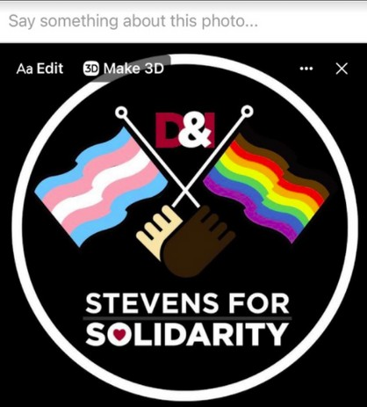
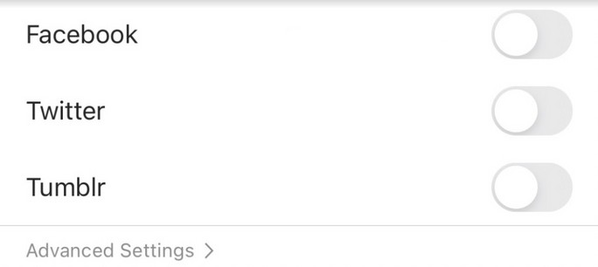

Right before you share a post, select 'Advanced Settings' at the bottom of the menu and add Alt Text to your photos.
Select '+ALT' in the bottom right corner of each picture you post to add Alt Text
Select the 3 dots in the top right corner of each picture you post to add Alt Text

Slide 10


Save #hashtags and @mentions for the end of a post for easier text-to- speech conversion.
Avoid alternative fonts on Instagram, Facebook and Twitter. Screen readers have trouble reading them.
𝖊𝖝𝖆𝖒𝖕𝖑𝖊
𝓪𝓵𝓽𝓮𝓻𝓷𝓪𝓽𝓲𝓿𝓮
σᖴ
𝕗𝕠𝕟𝕥
Alternative fonts require the use of external sites, typing directly in a social media site is best for screen readers.

Slide 11



Automatic closed captioning is now available for IGTV Live and IGTV. Use custom text to caption Instagram Stories.
Use custom text
Auto-generate captions or write them yourself. YouTube Community captions have been discontinued.
Auto-generate captions, write them yourself, or upload a SubRip (.srt) file. Automatic closed captioning is also available for Facebook Live.

Slide 12

Use gender-neutral pronouns (they/them) or check someone's profile for their preferred pronouns.
Avoid racist/sexist/ableist/insensitive language.

Slide 13



With the ongoing pandemic and the greater reliance on digital media, we must consider our role in being digitally accessible.
It is our duty to be aware of how we present ourselves online, and how to engage our communities, especially as leaders at Stevens.
The pledge was a way for people to commit to these actions and to serve as an example for community members now and to come.

Slide 14
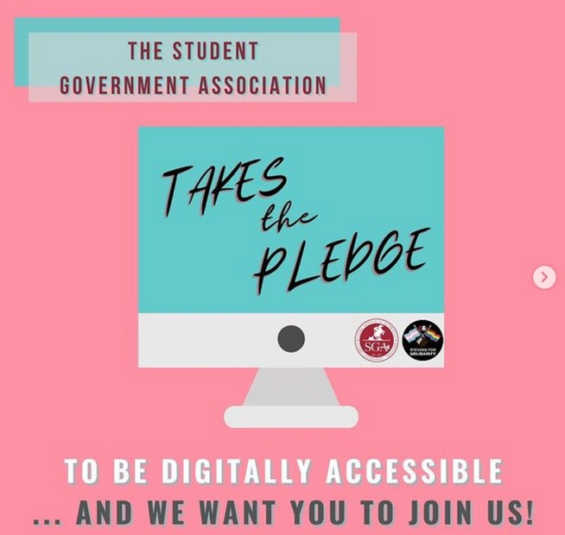
"We, [Organization Name], take the pledge to be more digitally accessible. This means following the guidelines as set in 'The Guide to Digital Accessibility,"'and being vigilant and aware of any other ways your organization can continue to promote inclusion in this aspect."

Slide 15



45 student organizations
Includes RSOs, Greek Life, and Non-RSOs
14 individuals
YOU!

Slide 16




Set some semesterly goals about how your office will become more digitally accessible
Ask how everyone is doing when you gather
Ask colleagues what they are doing to their digital media that they find is WORKING
When you find a successful method, share, share, share!

Slide 17

Hill, Patrick. "ES6 and Fundamentals of Web Development." CS554: Web Programming II, Stevens Institute of Technology.
Vesonder, Gregg. "Class 4 CS545." CS545: Human-Computer Interaction, Stevens Institute of Technology.
HTML Accessibility, W3Schools,
www.w3schools.com/html/html_accessibility.asp.
Sehl, Katie. “Inclusive Design for Social Media: Tips for Creating Accessible Channels.” Social Media Marketing & Management Dashboard, HootSuite.

